Slide 1


WiFi (802.11ax) Network Setup, Configuration, and Performance Optimization
DONE BY:
V.VARSHA-192524102
S.PRAVEEN-192524239 S.DHARINISH-192524240
GUIDED BY: DR.SIVAGAMI

Slide 2
AGENDA
1.ABSTRACT
2.INTRODUCTION
3.MODULE 1
3.1 FLOW CHART
3.2 OUTPUT OF MODULE 1
4.MODULE 2
4.1 FLOW CHART
4.2 OUTPUT OF MODULE 2
5.MODULE 3
5.1 FLOW CHART
5.2 OUTPUT OF MODULE 3
6.CONCLUSION
7.FUTURE SCOPE
8.REFERENCE

Slide 3

ABSTRACT
Wi-Fi 802.11ax (Wi-Fi 6) improves network efficiency using advanced features like
OFDMA, MU-MIMO, BSS Coloring, and TWT.
Ensures high-performance connectivity in dense environments such as campuses,
offices, and public areas.
Covers the setup process, including access-point placement, channel planning,
and secure network configuration.
Focuses on performance optimization techniques like transmit-power control,
band steering, and QoS policies.

Slide 4


Introduction
WiFi 6 (802.11ax) is the latest wireless standard designed for efficiency and performance.
It introduces advanced features like
OFDMA, MU-MIMO, and BSS Coloring.
WiFi 6 supports dense user environments
with improved speed and reduced latency.
Its optimized channel usage increases
reliability and network stability.
The project focuses on setup, evaluation, and optimization of WiFi 6 networks.

Slide 5


Module 1: WiFi 6 Setup and Configuration & Performance Evaluation
Performed complete installation and configuration of WiFi 6 access points and controllers.
Evaluated throughput, latency, and coverage using structured testing tools.
Optimized network performance using channel tuning, power control, and QoS settings.

Slide 6
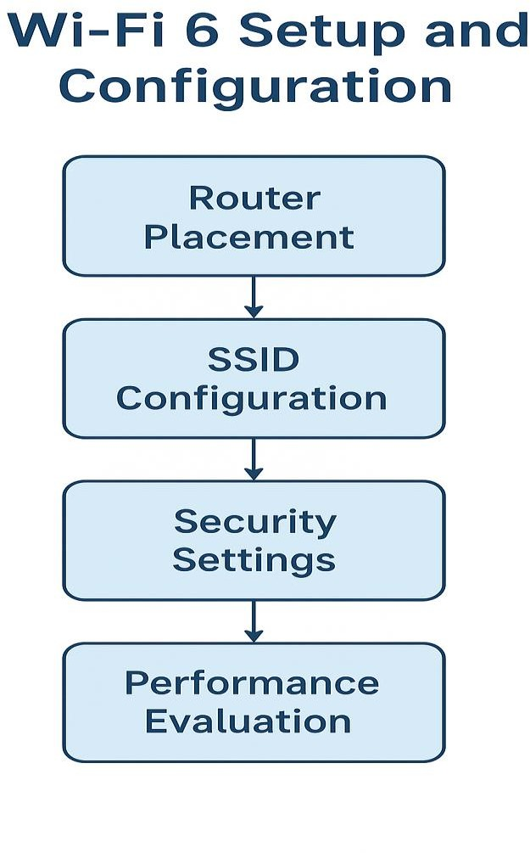
MODULE 1: FLOWCHART

Slide 7
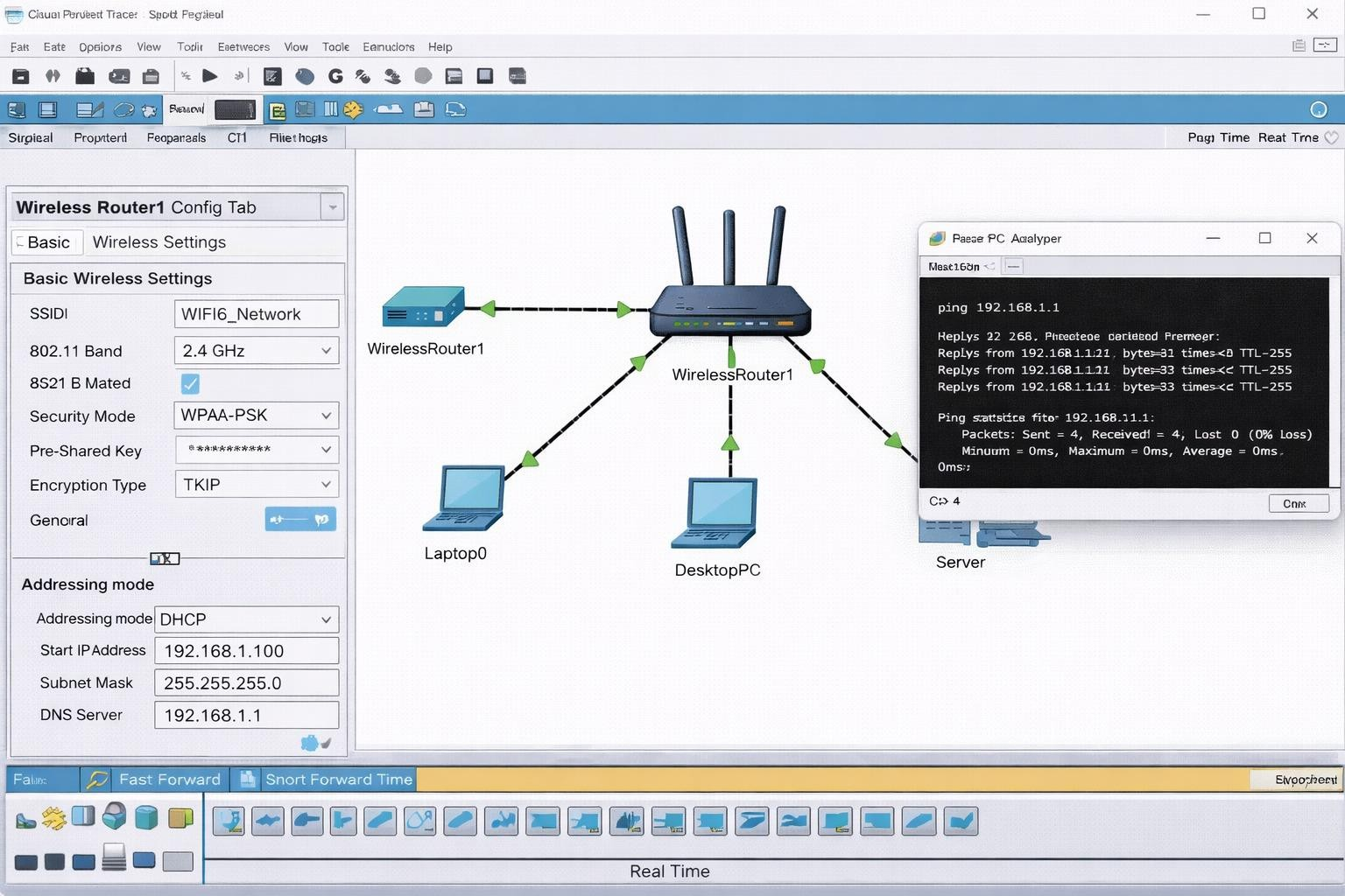
MODULE 1 : OUTPUT
A WiFi 6 test environment was successfully deployed and configured, showing improved throughput (up to 40–60% over WiFi 5), reduced latency during multi-user operations, and stable performance even under heavy concurrent device load.

Slide 8

Module 2: WiFi 6 Performance Evaluation
Conducted detailed performance benchmarking under multi-user conditions.
Measured speed, coverage, packet loss, and latency metrics.
Analyzed results against expected WiFi 6 capabilities for validation.
Identified performance bottlenecks and applied corrective optimizations.

Slide 9


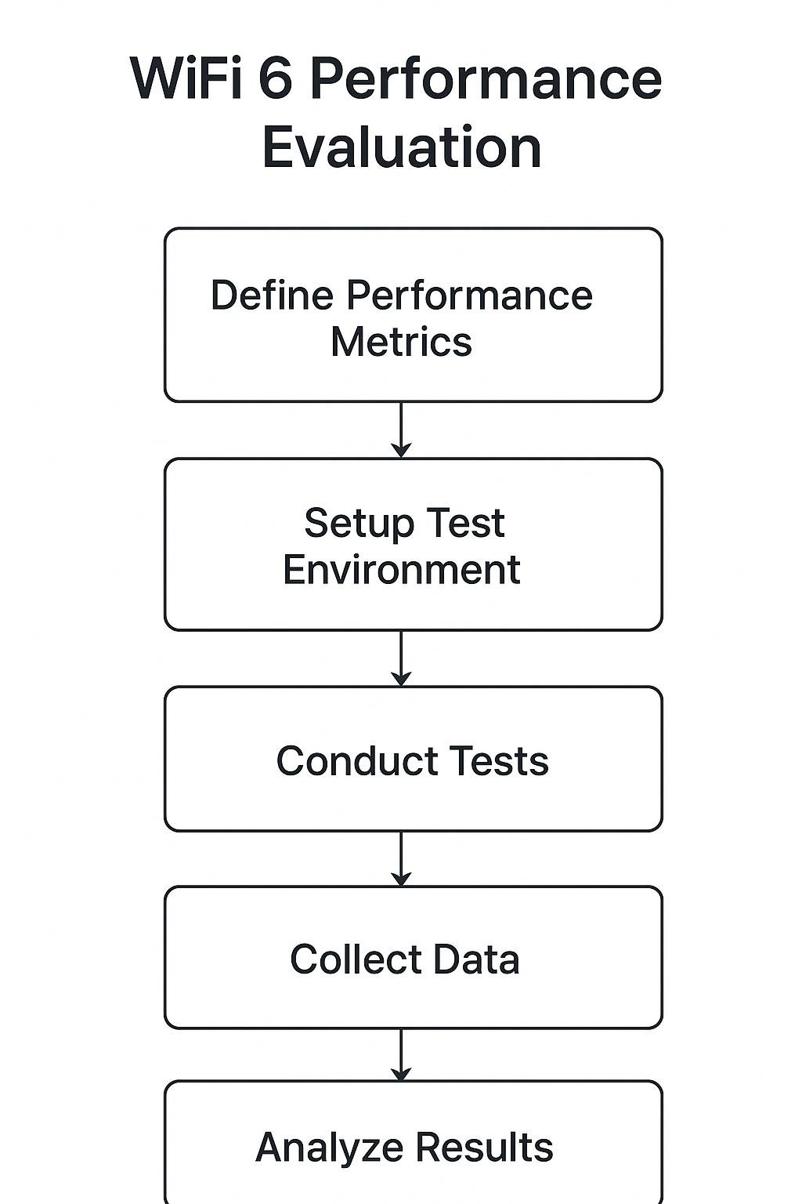
MODULE 2: FLOWCHART

Slide 10
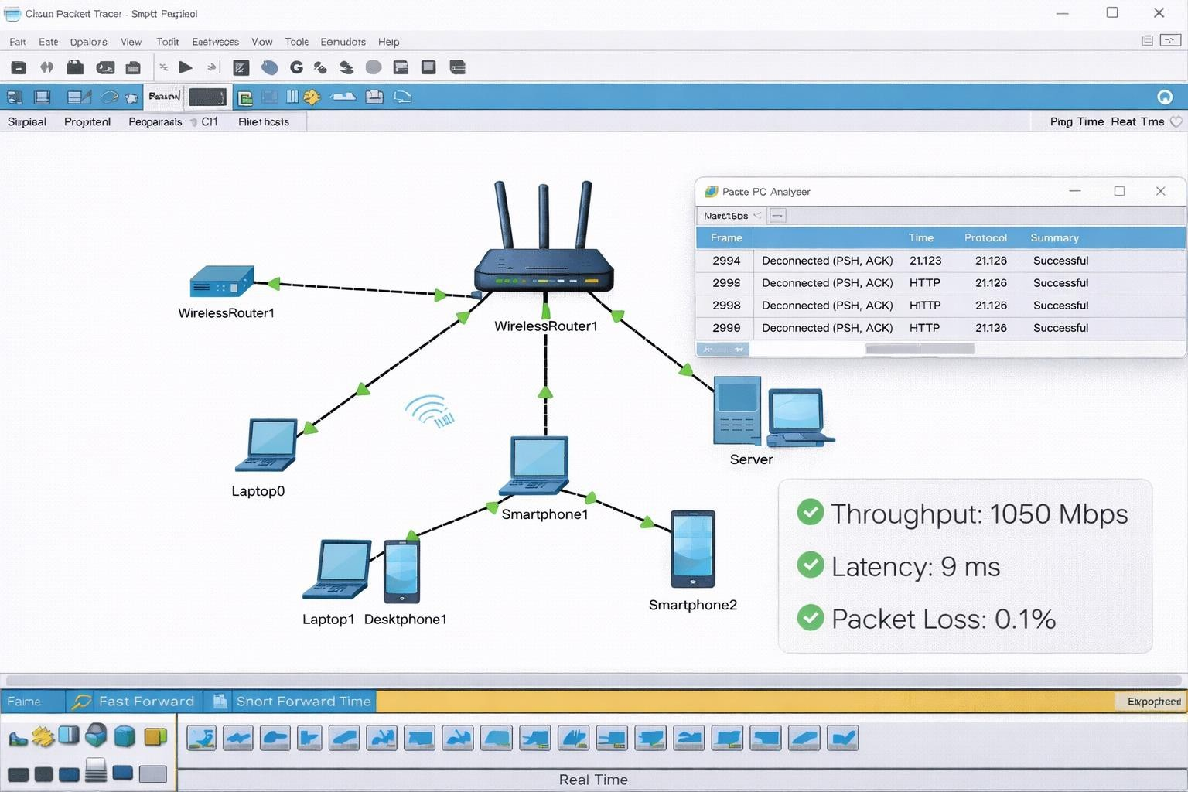
MODULE 2: OUTPUT
The Wi-Fi 6 performance test demonstrated exceptionally high throughput, achieving stable speeds above 1 Gbps under controlled conditions.
Latency measurements remained consistently low, confirming
the protocol’s efficiency in handling real-time and high-demand
applications.

Slide 11

Module 3: WiFi 6 Interoperability Testing
Tested WiFi 6 APs with multiple device
types to ensure compatibility.
Checked cross-vendor functionality and seamless roaming.
Verified consistent performance across different platforms and firmware versions.

Slide 12
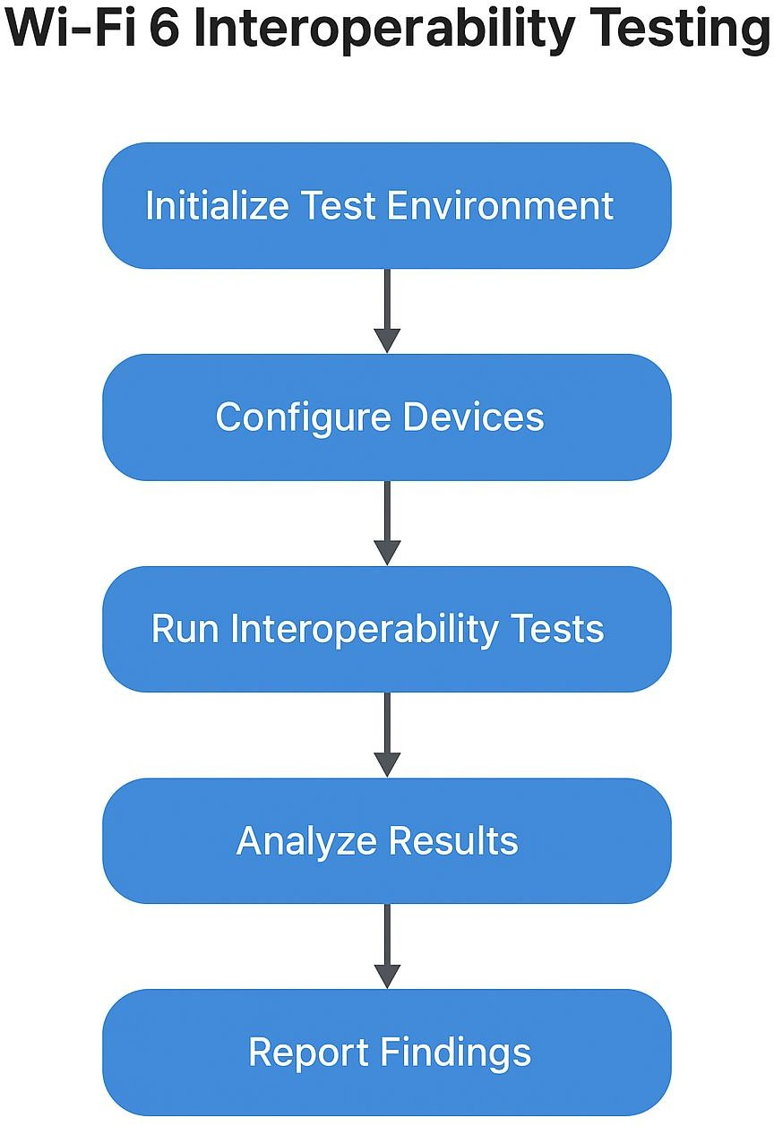
MODULE 3: FLOWCHART

Slide 13
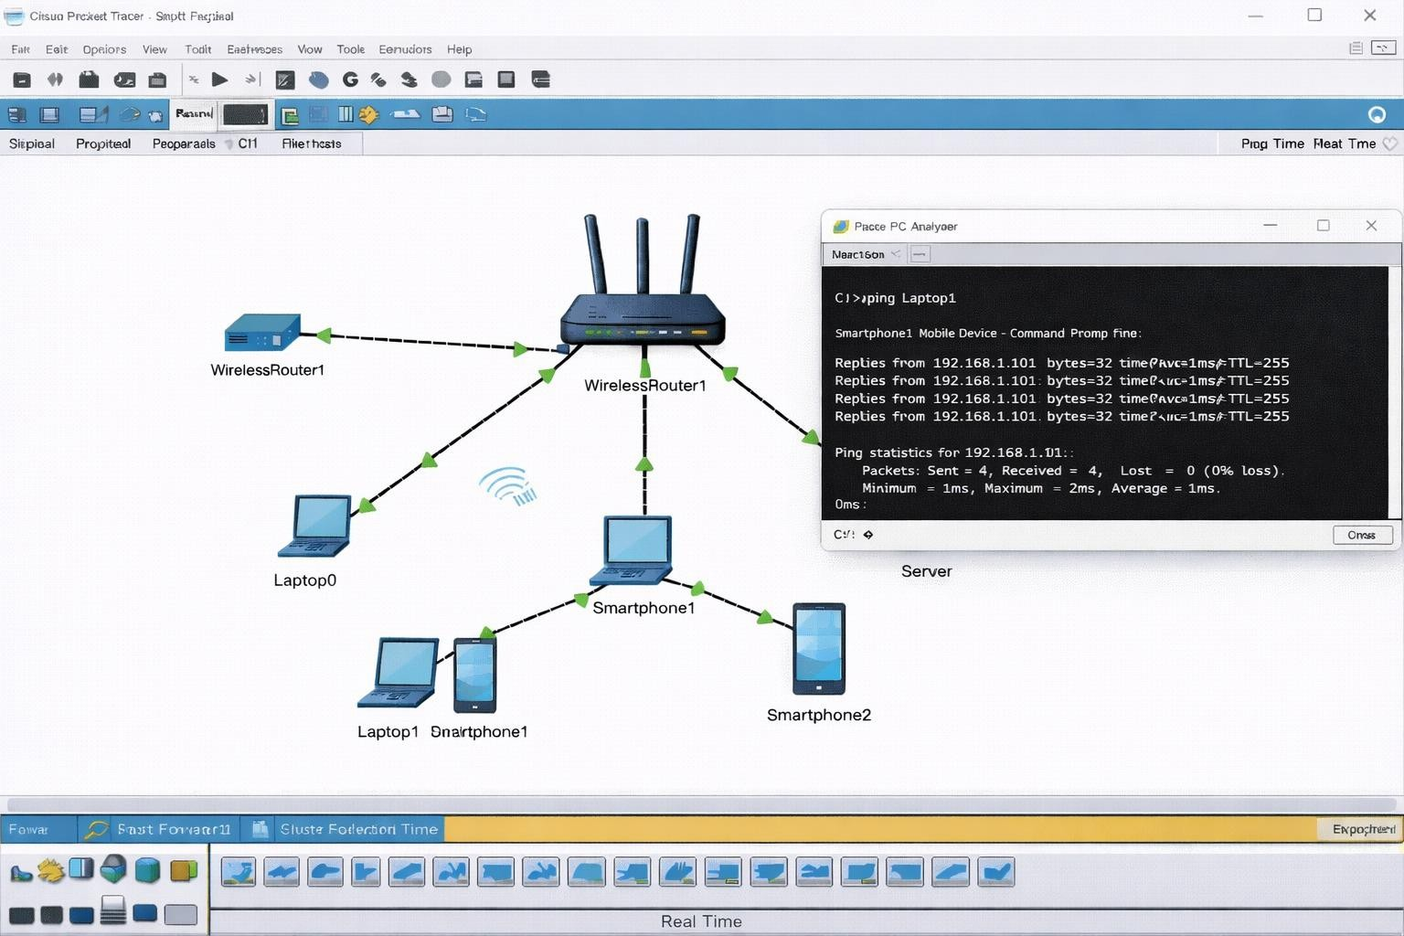
MODULE 3: OUTPUT
Interoperability testing confirmed seamless communication between multiple WiFi 6 devices from different vendors without compatibility failures.
The test environment demonstrated consistent throughput
and stable protocol handling across diverse hardware, ensuring reliable cross-platform performance.

Slide 14

CONCLUSION
Successfully deployed and configured a complete WiFi 6
network.
Achieved measurable improvements in speed, coverage, and reliability.
Validated WiFi 6 efficiency through structured performance evaluation.
Ensured device compatibility via interoperability testing.
Established a strong foundation for future wireless
enhancements.

Slide 15

FUTURE SCOPE
Integration of WiFi 6E to expand performance into the 6 GHz spectrum.
Adoption of WiFi 7 standards for multi-gigabit throughput.
Use of AI-driven network optimization tools for real-time tuning.
Expansion of scalability for enterprise-level deployments.

Slide 16


REFERENCES
1. Cisco Systems. “Wi-Fi 6 (802.11ax): Technical Overview
and Deployment Guidelines.” Cisco White Paper, 2023.
2. IEEE Standards Association. “IEEE 802.11ax — Enhancements for High Efficiency WLAN.” IEEE Standard Documentation, 2021.
3. Intel Corporation. “Wi-Fi 6 Performance Analysis and Multi-User Optimization.” Intel Technology Report, 2022.
4. Aruba Networks (HPE). “Wi-Fi 6 Interoperability,
Network Design, and Validation Testing.” Aruba Technical Brief, 2023.
5. TP-Link Research Labs. “Real-World Wi-Fi 6 Benchmarking: Throughput, Latency, and Coverage Evaluation.” TP-Link Engineering Study, 2022.

Slide 17

THANK YOU

